Slide 1
Computing Test Statistics
R. Garner, DePaul University

Slide 2
What is a test statistic?
A test statistic is a number that expresses the discrepancy between the observed sample outcome and the outcome we would see if the Null Hypothesis (H₀) were true about the population.
If it is a big discrepancy, the Null Hypothesis is very likely not true, and we can reject it with only a small probability that we are wrong.
If the discrepancy is big, it is evidence against the Null Hypothesis.
In this case, we say that the result was “statistically significant.”

Slide 3
The calculation of test statistics
Depending on the level of measurement of the variables (and some other info), we have to calculate different test statistics, but all of them ultimately are compared to probabilities for outcomes based on the normal distribution.
Generally, a test statistic with a large (absolute) value expresses a big discrepancy from the Null Hypothesis. It is unlikely (low p-value) to come up in the sampling distribution associated with the Null Hypothesis, and that allows us to reject the Null Hypothesis. The null hypothesis is probably not true about the population—but we can’t be sure.

Slide 4

Why the normal distribution?
Remember that the sampling distribution of the mean is:
A normal distribution (symmetrical; mean = mode = median).
Its mean (the mean of all the sample means) is equal to the population mean.
Its standard deviation is NOT σ, but σ/$\sqrt{N }$
Discrepancy from its mean is measured in Z-scores.

Slide 5
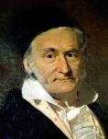
Who invented/discovered the normal curve?
Carl Friedrich Gauss (1877-1855)—an amazing mathematician!

Slide 6
T-tests
T-tests are used as test statistics when a mean is involved.
It could be a one-sample mean: is the mean for the sample very different from a baseline mean that expresses the Null Hypothesis?
Example: Are the reading test scores better with the new experimental reading program than they were with the existing program?
T-tests are also used to compare the means for two samples—are they different or not different? How different do the two sample means have to be in order for us to think the groups in the population have different means?
Example: Did kids in the charter school have better math scores than kids in the regular school?

Slide 7
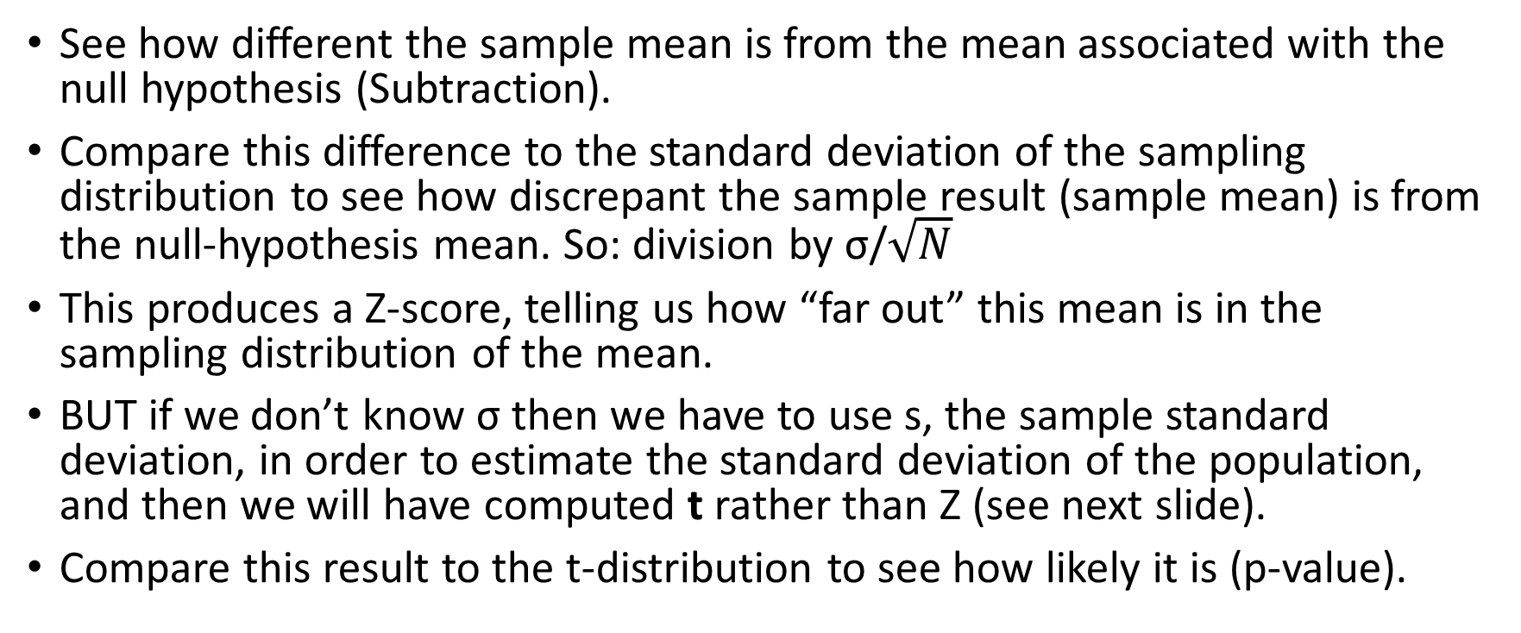
One-sample t-test
See how different the sample mean is from the mean associated with the null hypothesis (Subtraction).
Compare this difference to the standard deviation of the sampling distribution to see how discrepant the sample result (sample mean) is from the null-hypothesis mean. So: division by σ/$\sqrt{N}$
This produces a Z-score, telling us how “far out” this mean is in the sampling distribution of the mean.
BUT if we don’t know σ then we have to use s, the sample standard deviation, in order to estimate the standard deviation of the population, and then we will have computed t rather than Z (see next slide).
Compare this result to the t-distribution to see how likely it is (p-value).

Slide 8
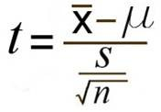
One-sample t-test formula
Using the sample standard deviation (s), and the mean hypothesized in the null hypothesis (mu) :

Slide 9
Is the computed t discrepant “enough”?
We compare our computed t to the histogram of the t-distribution (basically a normal curve but a bit flatter and “fatter” in the tails—more variability because we had to estimate its standard deviation from the sample data).
We have to look at its degrees of freedom based on the size of the sample: (n – 1)
Does our computed t exceed the critical value for the 0.05 level (or whatever p-value—aka alpha level—we want to use for our cut-off point for statistical significance)?

Slide 10
Story Problems
Our broccoli supplier is supposed to deliver bags that weigh one kilo, but we discover that the mean weight for a sample of 144 bags is only 0.98 kilos with a standard deviation of 0.03 kilos. Can we conclude that we are being short-weighted?
What if the sample standard deviation were 0.1 kilo?
Note that three “things” matter here:
The difference between the means
The sample size
The variability of the sample (standard deviation in the sample, which we use to estimate the SD in the population: s used to estimate σ)

Slide 11
Independent-samples t-test
Is the mean reading score for the charter school kids different from the mean reading score for the kids in the regular school?
The null hypothesis here is that if we subtract one of these means from the other, the difference is 0. (In other words, there is no difference in the scores.)
See Garner, Chapter 7 and Chapter 9, and also recommended, Wheelan, Chapter 9, Inference, Appendix for the formula.
(The tricky part is computing the pooled standard deviation, since both the sample size and the standard deviations are likely different for the two samples—you don’t need to memorize the formula, but you should be able to follow it.)

Slide 12
T-tests: proportions for binaries, as well as means
Remember that we can compute a mean for a binary variable, coded 0 and 1.
The mean is the proportion of “successes”—the proportion of cases that were coded 1.
So we can “do” t-tests for this type of proportion, as well as for a regular mean.
The variance is p(1 – p), where p is the proportion that were coded 1.
The standard deviation is the positive square root of the variance:
S = sqrt[p(1-p)]
Notice that unless the proportion is 0 or 1, the variance will be smaller than the standard deviation, and both numbers will be less than 1.

Slide 13
Story Problem 1: Means
We survey our subscriber base to get their rating of plays they saw during our annual season, using a scale of 100 points for the ratings.
A random sample of 200 subscribers gave August Wilson’s Fences a mean rating of 93.8, with a standard deviation of 4 points.
Another random sample of 225 subscribers gave our production of King Lear a mean rating of 90.7 with a standard deviation of 5 points.
Were the mean ratings of these two plays significantly different?

Slide 14
Story Problem 2: Proportions
In a random sample of 200 students from Prairie University, 35% say they follow vegan or vegetarian eating practices; in a random sample of 225 students from Coastal College, 40% say they follow vegan or vegetarian eating practices.
Can we conclude that the proportions are statistically significantly different at the two institutions?

Slide 15
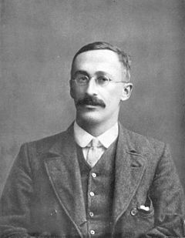

Who invented t-tests?
T-tests were invented (ca. 1908) by William Gossett, who worked for Guinness and had to publish under a pseudonym – “Student”.

Slide 16
Chi-square: a test statistic for cross-tabs (categoric level of measurement)
How do we construct the null hypothesis for a cross-tab?
First, we create a table of expected counts for the null hypothesis—for the hypothesis of complete independence (non-relationship) of our two variables.
Each cell count is computed by: (column total) x (row total)/N.
This table of “expected counts” has the same dependent-variable proportions for every category of the independent variable.

Slide 17
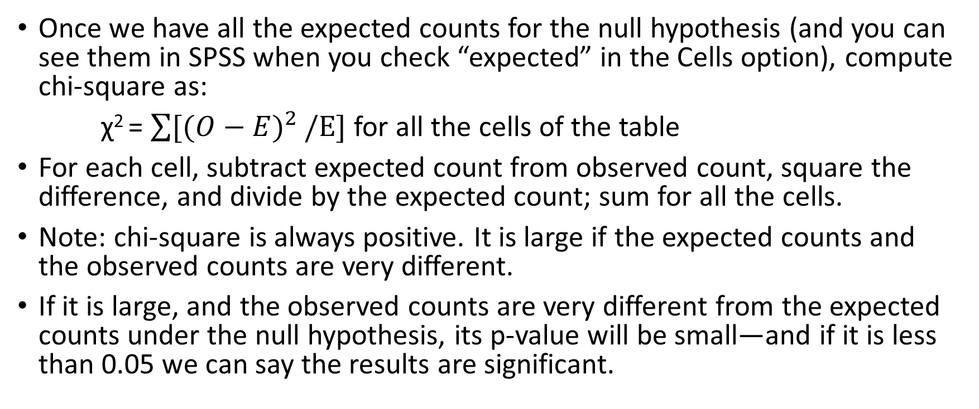
Chi-square (continued)
Once we have all the expected counts for the null hypothesis (and you can see them in SPSS when you check “expected” in the Cells option), compute chi-square as:
χ² = $\sum{{[(O−E)}^{2}}/E]$for all the cells of the table
For each cell, subtract expected count from observed count, square the difference, and divide by the expected count; sum for all the cells.
Note: chi-square is always positive. It is large if the expected counts and the observed counts are very different.
If it is large, and the observed counts are very different from the expected counts under the null hypothesis, its p-value will be small—and if it is less than 0.05 we can say the results are significant.

Slide 18
Story Problem 3: cross-tabs and chi-square
In a random sample of 200 Prairie University students, 25% report vegetarian eating habits, 10% report vegan eating habits, and the rest are carnivores. In a random sample of 225 Coastal College students, the proportions are 25% vegetarian, 15% vegan, and the rest carnivores.
Can we conclude that students at the two institutions have significantly different eating practices?
How is this story problem different from the preceding one (Problem 2)? Why is it best to use a cross-tabs and chi-square procedure?

Slide 19
Looking up the test statistic in a table of the distribution (Z, t, chi-square, F, etc.)
Once the test statistic has been calculated, we need to look at a table of its distribution to see if it is “big enough”—if its value exceeds the critical value and therefore is associated with a very small p-value (small probability that the null hypothesis is true, but we just got a “far out sample”).
SPSS looks up the test stat for us and prints out the p-value, but we can look it up in a table (this may entail looking up degrees of freedom which are related to sample size for t, to number of categories and cells for chi-square, and to both for an F test). Look at the Appendix of Charts in Garner or the distribution tables in any stats text.

Slide 20
Why 0.05? What is the p-value?
0.05 is the conventional choice for stating that the results are significant. We could use 0.1 but most people don’t.
This number is referred to as the alpha level, α. It is the risk of rejecting a null hypothesis that is in fact true—the probability of rejecting a true null hypothesis.
There is also another risk—the beta level, β, the risk of failing to reject a null hypothesis that is in fact false. For example, we might compute a chi-square that is too large to meet the alpha level standard, and we decide that the vaccine is not effective, when it really is, and we had just drawn a “bad” sample.

